Slide 1
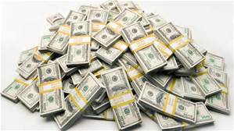
Top Ten Wealthiest Americans

Slide 2
With College Degrees
Without College Degrees
l
l
Dropped out of Harvard University Worth $72 billion via Microsoft Forbes Top 400 Rank (Sep. 2013): 1
MS in Economics from Columbia Business School Worth $58.5 billion via Berkshire Hathaway Forbes Top 400 Rank (Sep. 2013): 2

Slide 3
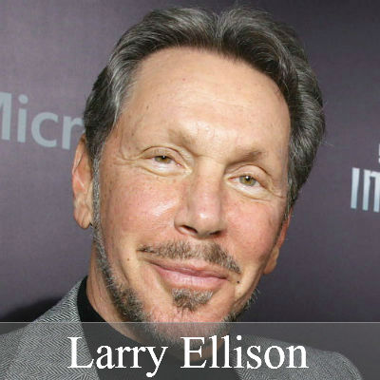
2
MS in mechanical engineering & MS in chemical engineering from Massachusetts Institute of Technology Worth $36 billion via Koch Industries Forbes Top 400 Rank (Sep. 2013): 4
Dropped out of University of Chicago & University of Illinois at Urbana Worth $41 billion via Oracle Forbes Top 400 Rank (Sep. 2013): 3

Slide 4
3
MS in chemical engineering from Massachusetts Institute of Technology Worth $36 billion via Koch Industries Forbes Top 400 Rank (Sep. 2013): 5
No college Worth $35.4 billion via Wal-Mart inheritance Forbes Top 400 Rank (Sep. 2013): 6

Slide 5
4
BA in Science from University of Arkansas Worth $33.8 billion via Wal-Mart inheritance Forbes Top 400 Rank (Sep. 2013): 7
Dropped out of City College of New York Worth $28.5 billion via casinos Forbes Top 400 Rank (Sep. 2013): 11

Slide 6
5
BA in Science from Trinity University Worth $33.5 billion via Wal-Mart inheritance Forbes Top 400 Rank (Sep. 2013): 8
Dropped out of Harvard University Worth $19 billion via Facebook Forbes Top 400 Rank (Sep. 2013): 20

Slide 7
6
Dropped out of University of Texas at Austin Worth $15.9 billion via Dell Forbes Top 400 Rank (Sep 2013): 25
JD from Columbia University Worth $33.3 billion via Wal-Mart inheritance Forbes Top 400 Rank (Sep. 2013): 9

Slide 8
7
 | Dropped out of Washington State University Worth $15.8 billion via Microsoft Forbes Top 400 Rank (Sep. 2013): 26
MBA from Harvard Business School Worth $31 billion via Bloomberg LP Forbes Top 400 Rank (Sep. 2013): 10

Slide 9
8
BA in Science from Princeton University Worth $27.2 billion via Amazon.com Forbes Top 400 Rank (Sep. 2013): 12
No college Worth $12.4 billion via oil & gas investments Forbes Top 400 Rank (Sep. 2013): 33

Slide 10
9
MS in Computer Science from Stanford Worth $24.9 billion from Google Forbes Top 400 Rank (Sep. 2013): 13
Dropped out of Washington University of St. Louis Worth $11.4 billion via Enterprise Rent-a-Car Forbes Top 400 Rank (Sep. 2013): 37

Slide 11
10
MS in Computer Science from Stanford Worth $24.4 billion from Google Forbes Top 400 Rank (Sep. 2013): 14
Dropped out of Baylor University Worth $9.8 billion via banks & real estate Forbes Top 400 Rank (Sep. 2013): 42

